Slide 1



Entergy New Orleans: TRM V9.0 Plan May 22, 2025
Notes:
Longest continually active Catholic church in America, from the 1700s.

Slide 2
TRM v9.0
Overview of proposed Updates

Slide 3

Introductions
Robert Oliver, Principal
Principal-in-Charge, Oversight of Contractual Issues
Zephaniah Davis, Director
Evaluation Manager, TRM Lead
Blake Heckendorn, P.E., Senior Engineer
C&I Evaluation Lead, TRM Support

Slide 4

Contents
Errata in TRM 8.0
Proposed New Measure Additions
Measure Study – Spray Foam ISR
Proposed Measure Study – Incremental Costs
Questions/Discussion

Slide 5


Errata from TRM 8.0
Volume and Chapter Number | Pages Number | Illustration/Description of Changes
Volume II, Section 2.3.5 | 241

Slide 6
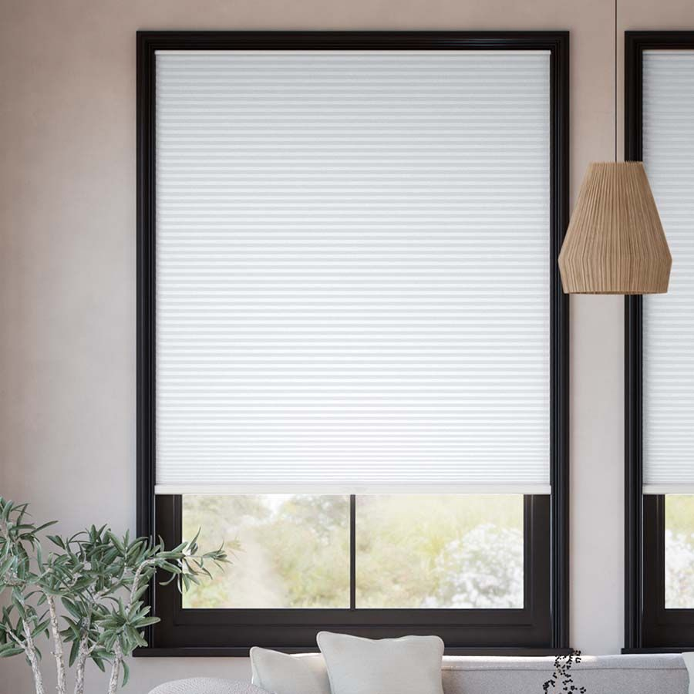


New Chapter additions (1/5)
Insulated Cellular Shades (Res)
Honeycomb structure: air gaps R-value 3.25 – 5
Significantly reduced heat transfer compared to traditional shades
2.15 kWh/ft²
IC: $40 per shade
EUL: 10

Slide 7
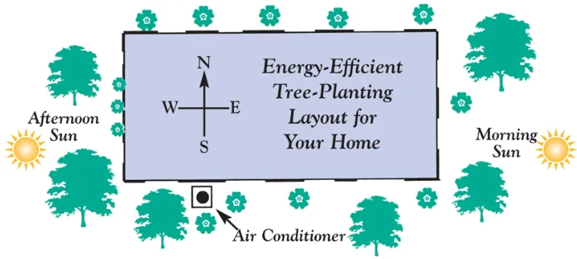

New Chapter additions (2/5)
Shade Tree Planting (Res)
Eligible types of native trees, focusing on low maintenance deciduous trees
Guidelines for optimal placement
Lower savings in first five years, significantly greater savings year 6-25
Algorithm-based savings
~70/kWh tree
IC: TBD (actual cost)
EUL: 25+

Slide 8
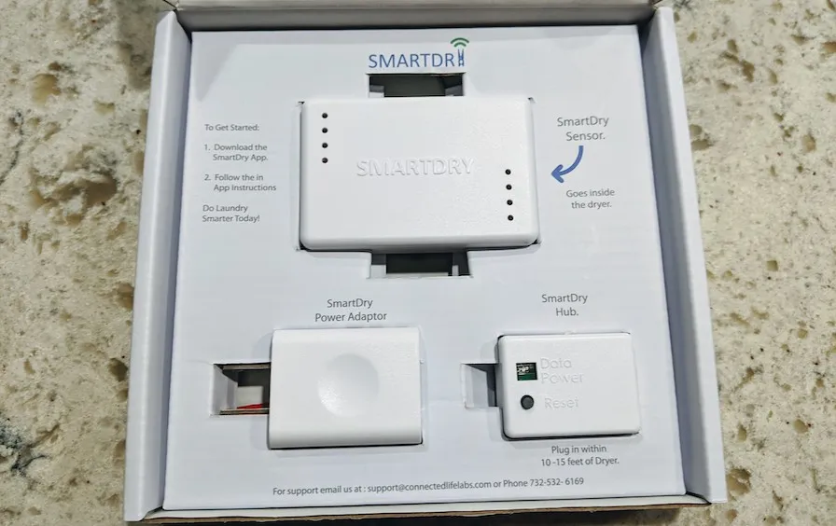

New Chapter additions (3/5)
Aftermarket Smart Dryer Sensor (Res)
Add-on device as opposed to a new dryer
Sensor that detects temperature and humidity in the dryer
A connected hub with built-in shut-off mechanism
Primarily residential applications, but will also include a deemed MF value for laundry rooms which are not coin-operated
Gas 25.3 kWh, ER: 134.0 kWh
IC: $60 for non-intrusive, $150
for fully attached
EUL: 16

Slide 9


New Chapter additions (4/5)
Building Operator Certification (COM/Public)
BOC Level 1
Efficient operation of HVAC systems
Measuring and benchmarking energy
Efficient Lighting Fundamentals
HVAC Controls Fundamentals
Indoor Environment Quality
Common opportunities for low-cost operational improvement
BOC Level 2
Building Scoping and Operational Improvements
Optimizing HVAC Controls for Energy Efficiency
Introduction to Building Commissioning
Peer project exchange
Not additive
≤500,000/ft²
0.274 kWh/ft²
IC: $1,695 training, $0.014/ft²
EUL: 13

Slide 10
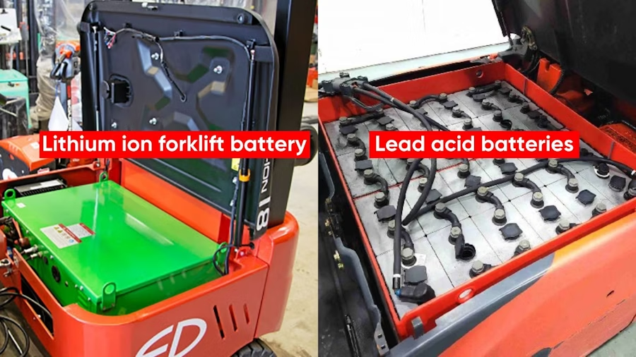

New Chapter additions (5/5)
Lithium Ion Forklift Batteries (COM)
Lower internal resistance compared with lead acid
kWh based on operation schedule:
IC: $17,200 vehicle,
$17,000 conversion
EUL: 15 years
Operation | kWh Saved
1-shift (8 h/d - 5 d/w) | 11,707
2-shift (16 h/d - 5 d/w) | 23,414
3-shift (24 h/d - 5 d/w) | 35,121
4-shift (24 h/d - 7 d/w) | 49,169

Slide 11
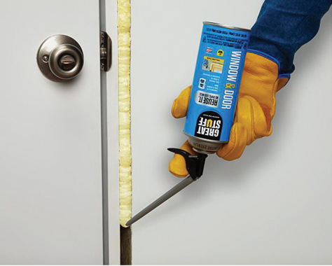

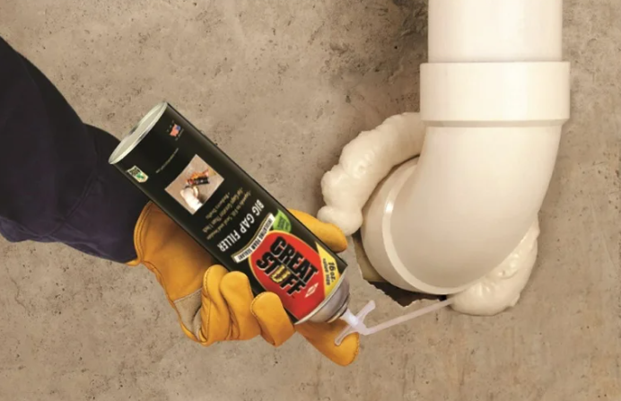
Data collection for Chapter revision
1.4.8 Polyurethane Foam Sealant
Introduced in TRM 8 with well-reasoned assumptions taken from PA TRM and implementor best estimates
Planned during first year of distribution that follow-up research would occur
ISR/use
Whether the can was used
Types of penetrations sealed
Total number/linear feet sealed

Slide 12

Special Study
Major Measure Incremental Cost Study 1/2
Current Practices
DEER
ADM speculates these are higher than in New Orleans
Issues in Applying External Sources
Equipment Costs
Installation Labor Costs
Measure Baseline
Surveys data collection:
Wholesalers, distributors and retailers in the New Orleans area
Labor rates of local contractors

Slide 13
Special Study
Major Measure Incremental Cost Study 2/2
Focus
HIMs (based on total kWh saved),
Incentives
Sensitivity to input factors
Residential | PY14 Expected Savings Share | Incentives Share
Duct Sealing | 35.6% | 21.5%
Air Infiltration | 15.6% | 17.3%
Central AC Tune-Up | 14.5% | 7.5%
Air Purifiers | 9.3% | 13.1%
Combined Share | 75.0% | 59.3%
C&I | PY14 Expected Savings Share | Incentives Share
VFDs | 20.5% | 9.4%
HVAC Tune-Up | 19.0% | 19.3%
Linear LEDs | 9.2% | 10.2%
LED Fixtures | 4.8% | 10.3%
Chillers | 4.3% | 4.5%
Combined Share | 57.8% | 53.7%

Slide 14
Questions?

