Slide 1
Resilience &
Storm Hardening
UD-21-03
Alliance for Affordable Energy
4th Technical Conference
July 24, 2024

Slide 2
PROPOSED METRICS
The Alliance has proposed metrics used in a distributional equity analysis (DEA) framework that:
allows utilities, regulators, communities, and stakeholders to answer questions about the equity implications of utility investments in grid resilience (including grid hardening and DERs) and
consider those implications alongside benefit-cost analysis (BCA).
DEA: includes additional metrics to provide energy equity data
separates customers into priority populations and other customers

Slide 3
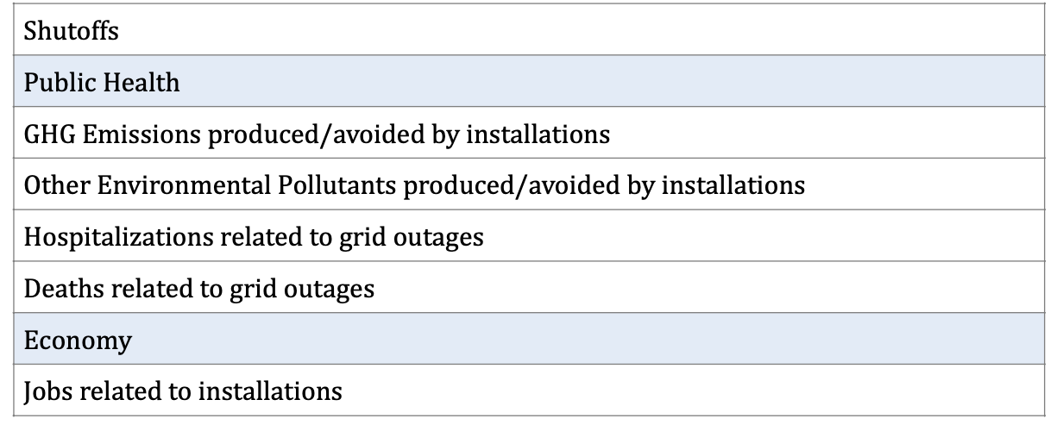
PROPOSED METRICS
The Alliance has proposed metrics that:
can be applied to many types of resilience investments, including grid hardening and DERs.
can be applied to different customer types, including priority populations such as vulnerable customers.

Slide 4
PROPOSED ENFORCEMENT MECHANISM
The Alliance has proposed Customer Average Interruption Duration Index (CAIDI), including major event days, as a key metric for resilience projects to ensure that promised resilience improvements actually materialize for customers.
An enforcement mechanism should be structured as follows:
For any year in which ENO’s CAIDI with major event days is between its target (desired performance) and its standard (minimum acceptable performance), ENO shall be found to be in compliance.
For any year in which ENO’S CAIDI with major event days is higher than its standard, ENO shall be penalized for noncompliance.

Slide 5
PRIORITY POPULATIONS
Resilience investments that can reduce the frequency and duration of outages for priority populations should be implemented first, considering factors such as:
Sociodemographic: income, age
Health: disability, mobility, medical devices that rely on electricity for life support
Climate: heat islands, low lying areas, locations facing the highest risks
Oldest infrastructure: neighborhoods with more frequent/ longer outages due to the need for system upgrades

Slide 6
QUESTIONS?

