Slide 1
Consumers Energy
Flint Initiative
Empowering Households.
Building Communities.
9/28/22

Slide 2
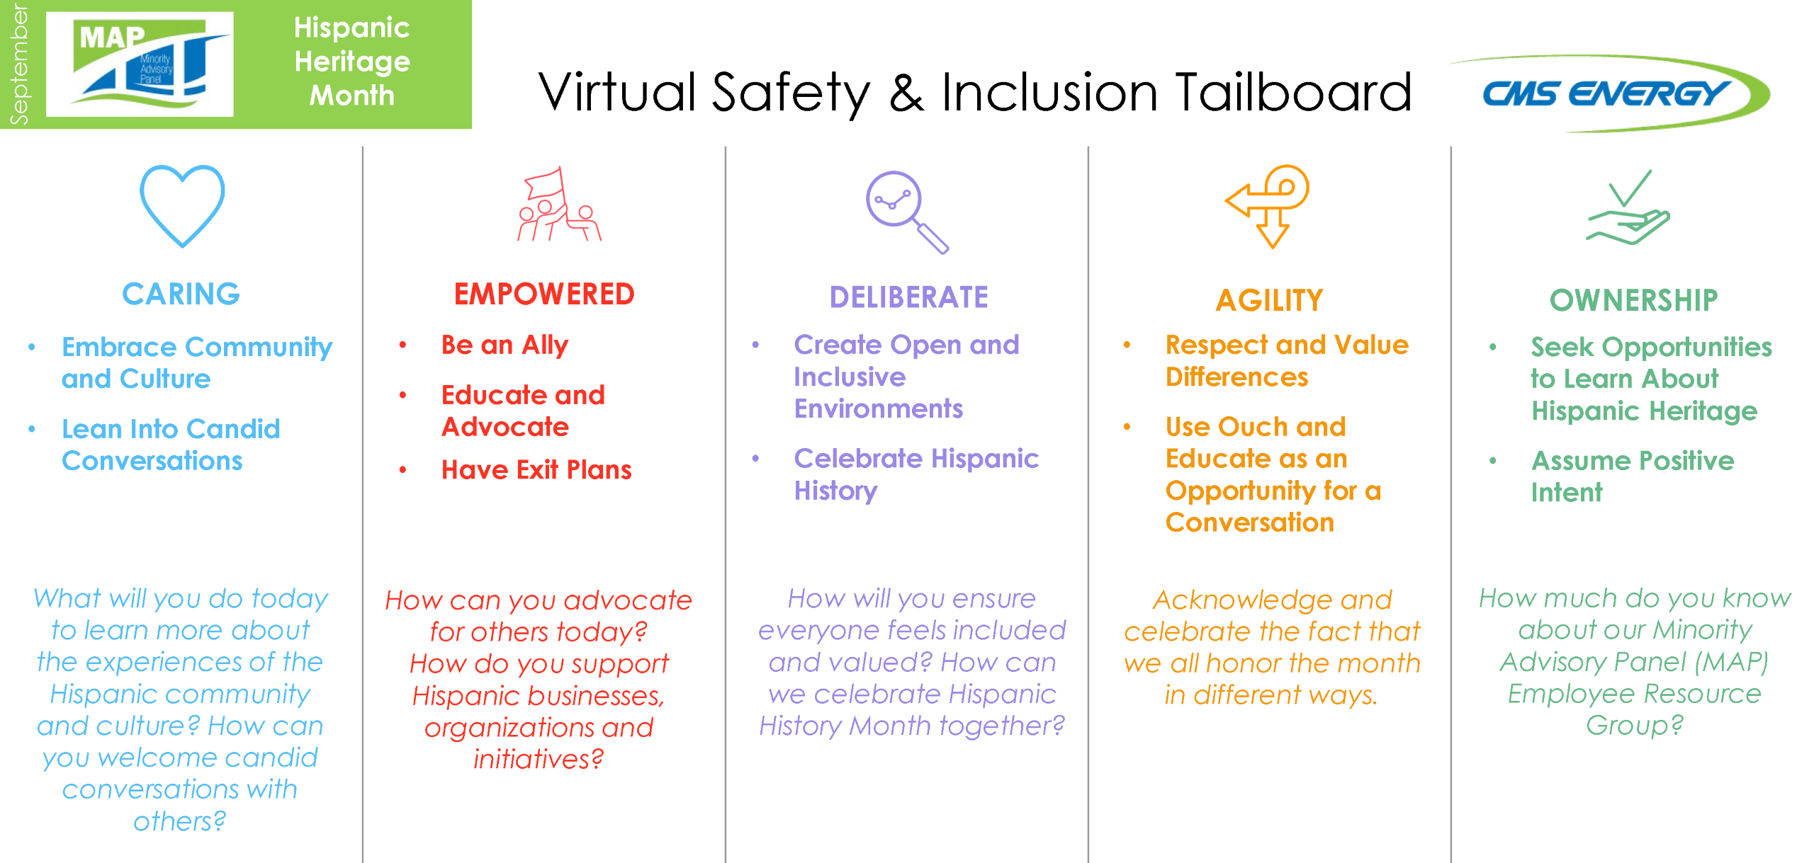

Slide 3
The Mission
Consumers Energy Income Qualified Products & Services will invest up to $1M between 2023 and 2024 to support energy efficiency improvements in a geographically targeted approach in and around Flint.

Slide 4
Our Purpose
Empower economically vulnerable customers
Community Orgs.
Target high need areas
Energy Assistance Coord.
Trade ally growth
In-home education

Slide 5
Our Approach
Products & Services
Community Organizations
Local Leaders
Businesses
Residents
Civic/
Municipal
Understand the current landscape & cultivate a path forward:
Define & understand the current income-qualified customer experience.
Collaborate with existing organizations to increase participation
Develop assistance solutions that are targeted to serve the community.

Slide 6
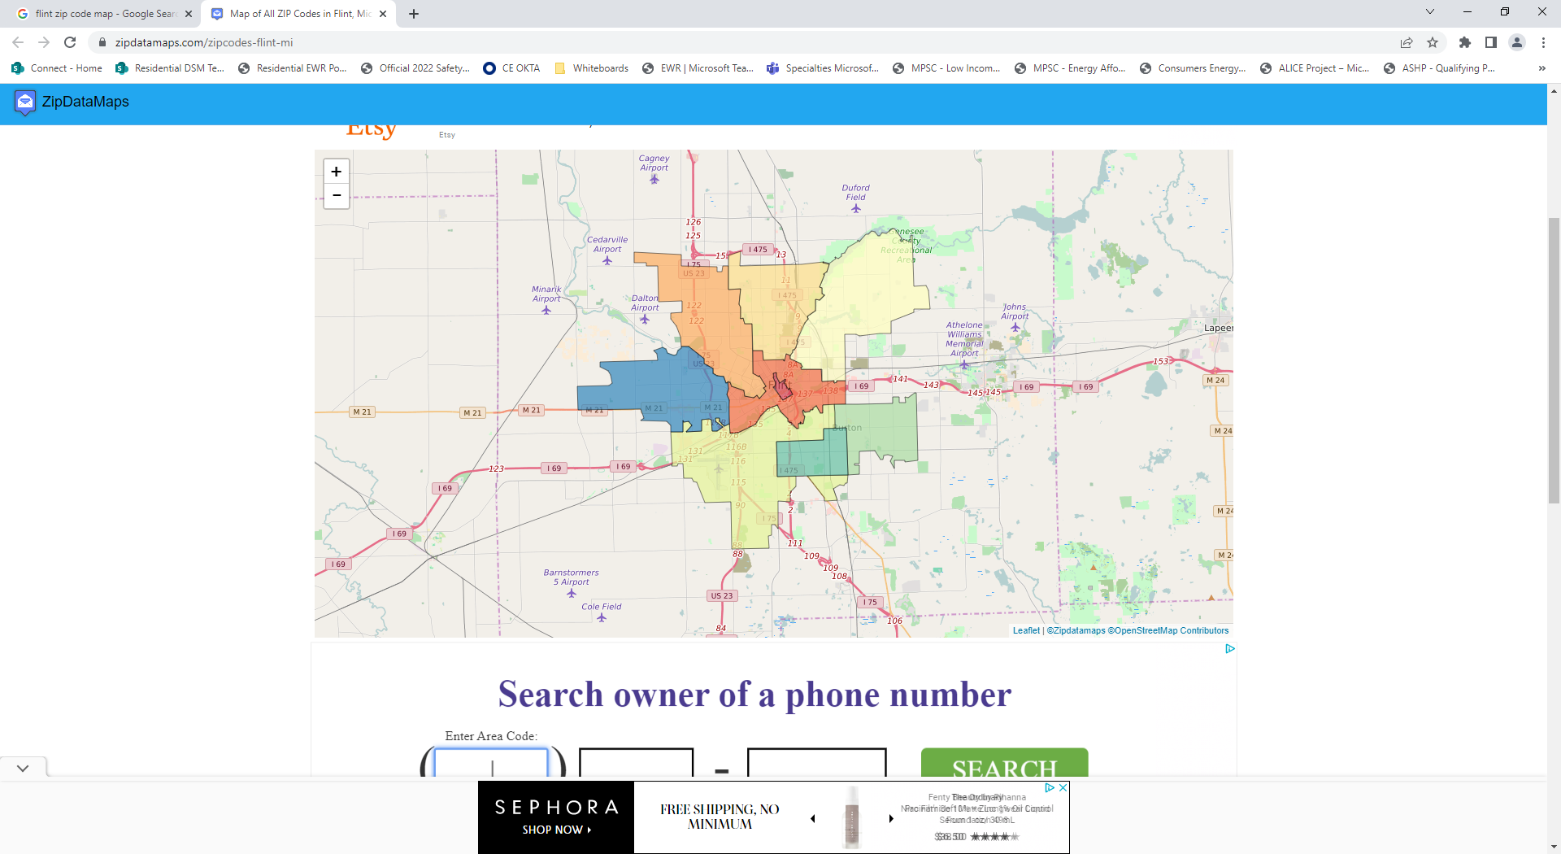
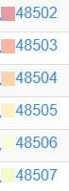
Target
Zip
Codes
6
1
5
3
2
4

Slide 7
Priority Outreach Targeting
Primary zip codes, then secondary zip codes
Utilization of LINA Prioritization scenarios
Targeted focus on those identified in CARE, LIHEAP, MEAP, and arrearage groups
Collaboration with Flint Lead Remediation program
Flint K-5 School THINK! programs/PTA

Slide 8
Estimated Annual Customer Targets
Zip Codes | Single Family | Multifamily | Total
48505 | 170 | 430 | 600
48503 | 130 | 820 | 950
48502 | 4 | 120 | 124
48507 | 160 | 570 | 730
48504 | 180 | 650 | 830
48506 | 90 | 590 | 680
Total | 734 | 3,180 | 3,914

Slide 9
Marketing Engagement
Tactics
Email
Direct mail
Digital media campaigns
Hotline/outbound calling
Coordination with K-5 THINK! program
Collaboration with City officials /LEAD Remediation programs
Trade Ally Engagement

Slide 10
Community Outreach
  Engage community leaders
    Flint Area Schools K-5
    Hurley Care program
    LEAD Remediation program collaboration
  Participate at the neighborhood level
  Continue connections with local agencies for referral and or collaboration opportunities

Slide 11
Evaluation Plan
Evaluation Task | Research Objective | Methodology | Timeframe | Metrics Tracked
1. Flint Community Org Interviews (Cadmus) | Understand the needs & barriers of IQ customer in Flint and gather feedback about the design of the Flint Initiative | Conduct phone interviews with organizations serving IQ community in Flint to identify barriers to program service in the area and reactions to preliminary program design | Kick off in October 2022 Completed by end of 2022 | Agency participants Agency non-participants Barriers / needs / recommendations
2. Flint Customer Surveys (Cadmus) | Understand the needs & barriers of IQ customer in Flint, gather feedback about the design of the Flint Initiative, and test the program concept with eligible Flint residents to understand if enhancements should be made | Conduct online surveys with IQ customers in Flint to understand how to better serve customers through EWR/DR products | Completed by end of Q1 2023 | Participants Non-participants Barriers / needs / recommendations
3. Flint Geotargeting (Cadmus) | Identify priority households for Flint Initiative targeting; use characterization data to identify priority areas for the initiative to target based on concept design | Develop a protocol & implementation strategy for geo-targeting Utilize geographic analysis to identify areas where households are clustered & characterize those areas with other customer metrics to determine a lead list for targeted engagement | Complete by end of 2022 | LINA scenario prioritization metrics used to inform this research Participation before & after

Slide 12
Next Steps
Project team is working internally to develop data/tracking processes
Development of standardized reporting
Finalize project plan – 10/1
  Launch 1/1/23

Slide 13
Thank You!
Individual Customer Participation
Energy Assessments For Your Home
Visit ConsumersHelpingNeighbors.com Or call 877.448.9433 (Option 1)
Amy Glapinski
Clean Energy Products
Low Income Product Portfolio Manager
Amy.Glapinski@cmsenergy.com
Yvonne K. Lewis
Clean Energy Products
Low Income Single Family Product Manager
Yvonne.Lewis@cmsenergy.com
Agency Collaboration Opportunities
ConsumersRehabReservations@clearesult.com
Shawn Starkweather
Clean Energy Products
Low Income Multifamily Product Manager
Shawn.A.Starkweather@cmsenergy.com
Multifamily Energy Efficiency
www.consumersmultifamilysavings.com

