Slide 1

Demand Side Management Potential Study
Methodology Overview
Council Docket No. UD-17-03
4 April 2018

Slide 2
DSM Potential Study in Context
Outputs of Potential Study become inputs to IRP
Distinct from the study being conducted for Entergy New Orleans by Navigant
Limited to efficiency, demand response, and rate design opportunities
Attempting to use as much local data as practical, but no primary data collection
Time-constrained, must be completed in four months

Slide 3
Optimal Energy Team Introductions
Optimal Energy, Inc.
  Leading practitioner of potential studies; “wrote the book”
  Technical consultant to energy efficiency advisory councils in leading states
  Clients include IOUs, municipal utilities, state energy offices, consumer advocates, and non-profits
American Council for an Energy-Efficient Economy (ACEEE)
  America’s leading center of expertise on energy efficiency for 35 years
  Quality, credibility, and applicability of their work, relied on by policymakers, utilities, business decision makers, consumers, the media, and energy professionals
  Numerous local, state, and regional studies of efficiency potential, in all regions of the United States and Canada
The Caulfield Consulting Group
  Local partner for national firms on a variety of important, interview-focused, research projects.
  Deep knowledge of and relationships with a number of key New Orleans stakeholders.

Slide 4
Study Timeline
Final Measure List – May 5
Measure characterizations and other inputs – through May
Measure adoption curves and penetrations – by June 9
Draft achievable potential – by July 6
Draft report – by July 20
Stakeholder meeting on draft report – week of July 23 or July 30
Stakeholder comments due – August 17
Final report and IRP inputs – August 31

Slide 5
Study Overview
20-year energy efficiency potential study, 2018-2037
Electric measures only, results to inform Entergy’s IRP
Energy efficiency, demand response, and rate structures
Residential, commercial, and industrial sectors
  Transportation efficiency not included
Economic, maximum achievable, and program potential.

Slide 6
Technical / Economic / Achievable / Program Potential
Technical
Economic
Maximum Achievable
Program
The theoretical maximum amount of energy use that could be displaced by effi­ciency
Subset that is cost-effective
Subset that is achievable considering market barriers, given the most aggressive program scenario possible
Subset of achievable, given constraints in implementing a particular portfolio of programs

Slide 7

A Note on Cost-Effectiveness…
Measures the relative performance or economic attractiveness of an energy efficiency investment compared to a baseline of not making the investment
Compares the present value of costs & benefits of efficient equipment with those of baseline (non-efficient) equipment

Slide 8
Cost Effectiveness Tests
Notes:
TRC will include Non-Energy benefits where justifiable and quantifiable (lighting O&M), as well as estimate of value of avoided carbon emissions

Slide 9
“Top-down” Analysis
Begins with energy sales forecast
  Disaggregated by sector, segment (typically building type), and end-use
Measure savings expressed as a percentage of total applicable end-use energy
  Generally by building type and market (new construction, renovation, replacement, retrofit)
Measure costs in terms of $/kWh saved
Penetrations are a percent of total available savings in any given year
In contrast to “bottom up” analysis which expresses costs and savings per “widget”

Slide 10
Estimate “Applicable End-Use Energy”
Determined from the sales disaggregation & equipment saturation
By end-use and building type
  Applicability (to a particular technology)
  Feasibility (technically feasible)
  Turnover rate (natural replacement)
  Not-complete (retrofit)
Energy Savings | = | Sales (kWh or MMBtu) | x | Applicability Factor | x | Feasibility Factor | x | Turnover Factor (replace-ment only) | x | Not Complete Factor (retrofit only) | x | Savings Fraction | x | Net Penetration Rate
Notes:
Cliff starts here

Slide 11
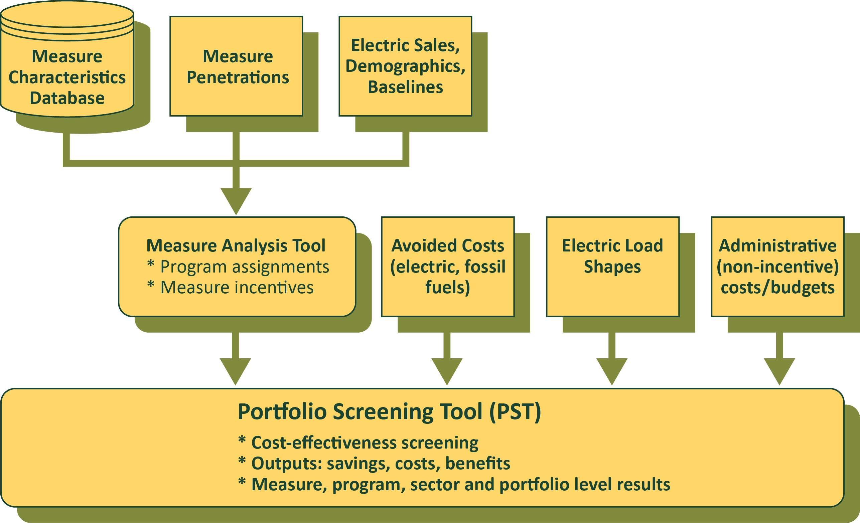
Analytical Workflow

Slide 12
Baseline Sales Forecast and Disaggregation
Forecast energy sales by sector over analysis period (i.e., 2018-2037)
Separates new construction vs. existing building sales
Disaggregate forecast by segment and end-use
Adjust forecasts as necessary to reflect baseline:
  Remove embedded program efficiency
  Estimate embedded codes & standards impacts
  Remove “opt-out” industrial sales
  Remove non-building sales (e.g., transportation)

Slide 13
Proposed Segmentation, Building Types

Slide 14
Proposed Segmentation, End-Uses

Slide 15
Interactions and Exclusivity
Stock adjustments
Measure interactions
  e.g., building shell improvements interact with efficient cooling/heating equipment
Mutually exclusive measures
  i.e., can do one or other, but not both

Slide 16
Measure Characterizations
Inputs describing all aspects of the measure (e.g., costs, savings, lifetimes)
Adjust savings to local conditions (code and NOLA practices)
Characterizations may vary by market and program intervention strategy
Measure will include:
  Conventional measures
  Emerging technologies and practices
  Behavioral measures
  Load management and DR
  Rate Structures

Slide 17
Measure Characterization Inputs
Full measure characterizations include numerous inputs…
General Inputs
  Sector
  Primary Fuel and End Use
  Secondary Fuel and End Use
  Measure Effective Useful Life (EUL)
  Baseline EUL (if different)
  % Savings (Primary Fuel, relative to baseline)
  Secondary Fuel Savings (relative to primary fuel savings, MMBtu/kWh or kWh/MMBtu)
  Efficient Equipment Cost
  Baseline Equipment Cost
  Incremental Cost per kWh or MMBtu Saved
  Measure Interactions
  Measure Mutual Exclusion
O&M and Water Inputs:
  Efficient Component Life
  Efficient Component Replacement Cost
  Baseline Component Life
  Baseline Component Replacement Cost
  O&M Levelized Annual Cost
  Water Savings
Early Replacement Retrofit Inputs:
  Baseline Remaining Useful Life (RUL)
  Baseline Cost per kWh or MMBtu Saved
  Baseline Shift Savings Factor
Measure Inputs by Building Type:
  Loadshape and Peak Coincidence Factors
  Applicability
  Feasibility
  Not Complete RET
  % Savings (if variable by building type)
  Penetrations

Slide 18
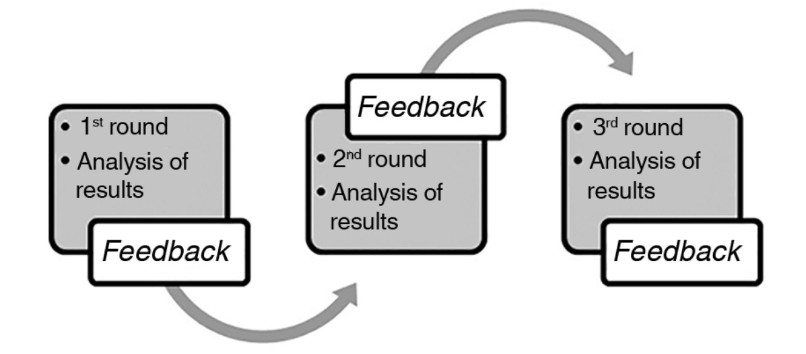
Measure Penetrations and Delphi Process
Penetration curves model energy efficiency adoption over time
Achievable and program potential penetrations consider market barriers
  Costs
  Customer Awareness/Willingness
  Equipment/Contractor Availability
  Budget Constraints
  Other market barriers
Delphi Process will be used to develop penetration curves

Slide 19
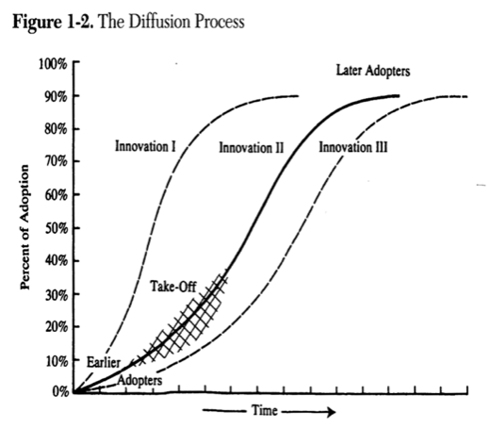
Measure Penetrations

Slide 20
Portfolio Cost-Effectiveness Screening
Full accounting of technology costs, including capital, fuel, operation and maintenance, and cost offsets such as non-electricity savings and non-energy benefits.
Proper accounting for the benefits, calculated using annual values of long-run avoided energy costs.
Precise treatment of various timing effects such as baseline shifts and deferred replacement credits
Calculate standard cost-effectiveness tests, e.g., Utility, Participant, Total Resource, and Ratepayer Impact

Slide 21
Cost-Effectiveness Screening Inputs
Financial Inputs (e.g., inflation and discount rates)
Avoided costs
Line loss factors
Load shapes
Peak coincidence factors
Program non-measure (non-incentive) costs
Measure inputs

Slide 22
Avoided Costs
Estimates of current and future costs for energy on the margin
Used to calculate $ benefits of saved energy
Avoided cost components typically include:
  Generation energy
  Peak capacity
  Transmission and distribution capacity

Slide 23
Load Shapes
Distribute annual savings by energy period
Generally by end use and building type
Can derive from hourly “8760” usage data
  Specific to geographic region & climate

Slide 24
Peak Coincidence Factors
Portion of demand reduction occurring at peak demand
Can derive from “8760” usage data
  Based on max kWh/kW ratio

Slide 25

Emissions
CO₂, NO_{X}, SO_{X}
Factors for energy generation offset on the margin
Only CO₂ monetized as externality, others included in avoided costs
Notes:
Jeff picks here

Slide 26
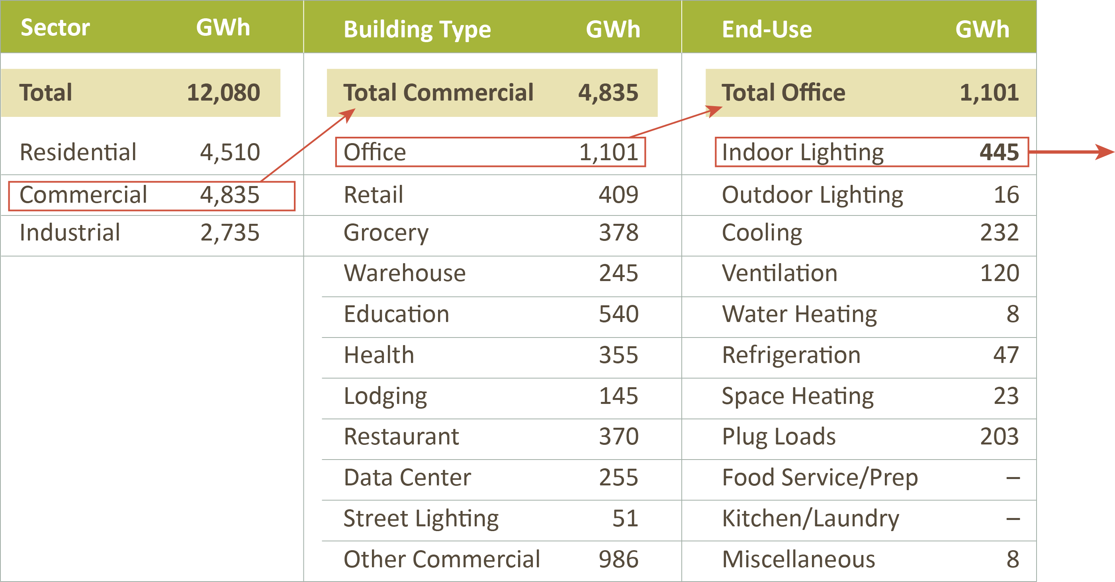
LED Linear Replacement Lamp, Replace On Burnout
Electric Measure Potential Example

Slide 27
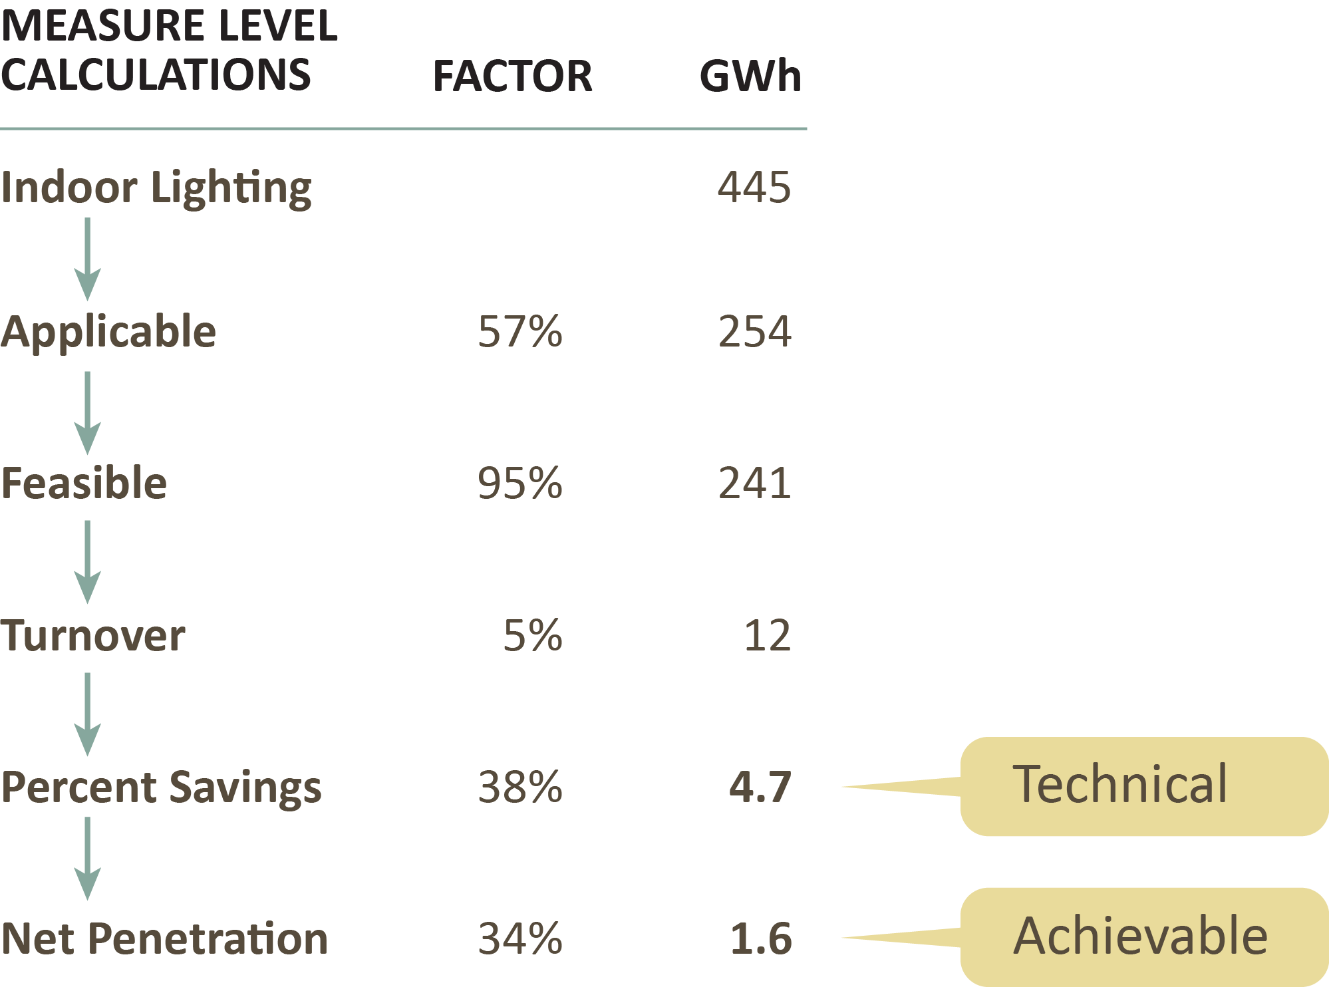
LED Linear Replacement Lamp, Replace on Burnout
Electric Measure Potential Example

Slide 28
Opportunities for Demand Response
Load reductions based on results in nearby service areas (e.g., Arkansas)
Similar in concept to efficiency potential
Several technology and program measures to reduce peak demand, considering interactions
Emerging technologies and AMI-enabled DR

Slide 29
Impacts of Electric Rate Design
Estimate impacts of rate designs on customer behavior
  Total consumption
  Timing of consumption
  Peak demand
Methodology
  Previous studies of customer response to rate changes
  Sensitivity analysis
Emerging technologies and AMI-enabled rates

Slide 30
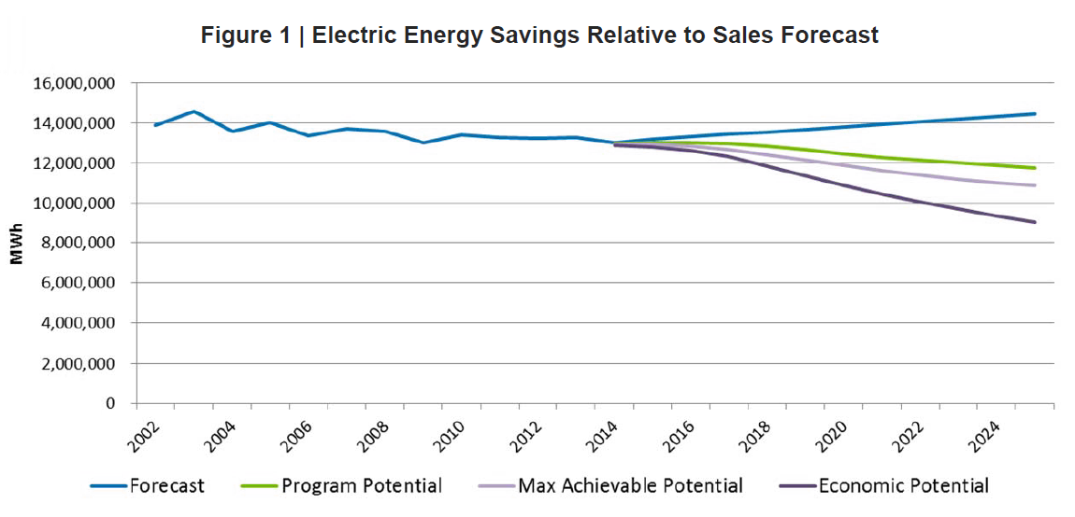
Example Outputs – Charts and Figures

Slide 31
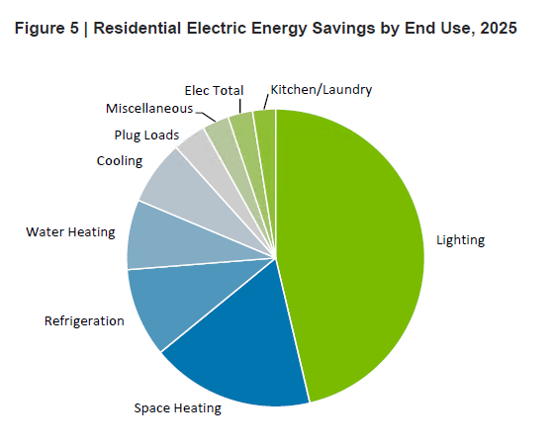
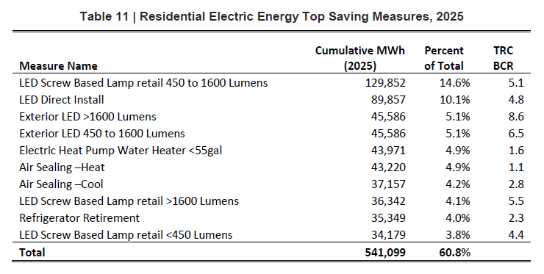
Example Outputs – Charts and Figures

Slide 32
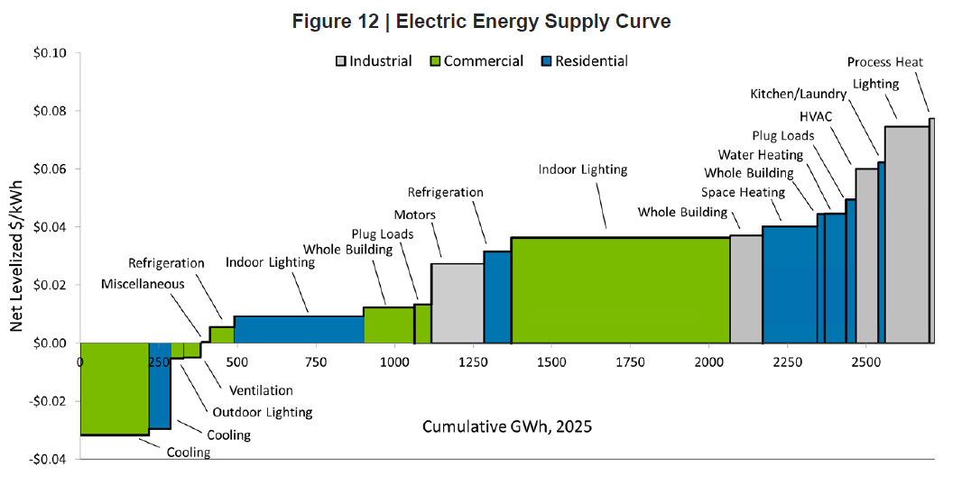
Example Outputs – Charts and Figures

Slide 33
Key Outputs of Analytical Tools
“8760” hourly energy savings for input to Entergy’s IRP Analysis
Program-level savings by year, at meter and at generation
Program costs by year, including incentive and non-incentive costs
Cost-effectiveness for each program
Program-level summaries of costs and benefits, discounted to the base year
Levelized costs by program and for the portfolio
Emissions reductions by program

Slide 34
Additional Discussion Items for Report
Meta-analysis comparing results to other studies in Louisiana and Southeastern US
Qualitative discussion on RIM test, including estimated rate and total bill impacts from EE
Qualitative discussion of other likely but difficult to quantify benefits (e.g., DRIPE)

