Slide 1
Demand Side Management Potential Study Measure List Overview
Council Docket No. UD-17-03
4 April 2018

Slide 2
Measure List Topics
Measure variants and applicability
Potential study measures vs. TRM measures
Sector-by-sector review
TVR and DR measures

Slide 3
Measure Variants and Applicability
Similar measures installed in different situations, with different drivers
New construction/renovation
End of life/replace on failure or “burnout”
Early retirement/retrofit
Both savings and costs vary
Market | Baseline | Efficient | Equip. Cost | Labor Cost
NC/ROB | Code/standard¹ | Higher | ∆ | 0
Retrofit | Existing² | Code/standard | Full³ | Full
¹Or standard practice ²Baseline shift ³Deferred replacement credit

Slide 4
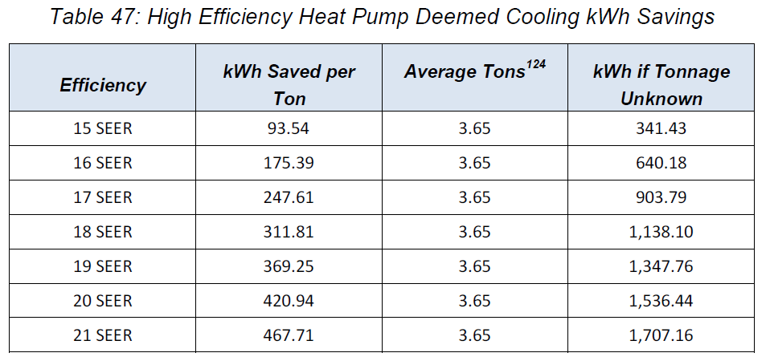
Study measures vs. TRM measures
Different purposes
TRM: ensure accurate counting of actual, installed measures
Potential study: ensure accurate estimate of available potential at moderate level of detail, using averages
Example: residential heat pump

Slide 5
Sector-by-sector review – Residential
Lighting market changes
Reviewing codes, handling market shifts
Emerging technologies
Lighting controls
EMS
Window attachments
Other end-uses
Outdoor lighting
Heating, ventilation, and air conditioning (HVAC)
Domestic hot water (DHW)
Appliances and consumer products
Building shell (“envelope”)
Notes:
Likely to be steep declines in residential lighting savings, potentially zero by 2022 or so
Need some more info about current market in NOLA.

Slide 6
Sector-by-sector review – C&I
Lighting market changes
Reviewing codes, handling market shifts
Emerging technologies
Lighting controls
SEM
HVAC controls
Other end-uses
Outdoor lighting
Heating, ventilation, and air conditioning (HVAC)
Domestic hot water (DHW)
Refrigeration and commercial kitchen
Appliances and consumer products
Compressed air
Data centers
Building shell (“envelope”)

Slide 7
TVR and DR measures
Time-varying rates
Time of use (TOU)
Real-time pricing (RTP)
Critical peak pricing (CPP)
Peak-time rebates (PTR)
Demand response
Bring-your-own-thermostat (BYOT) (Res)
Home energy displays (Res)
Direct or AMI-enabled HVAC/DHW control (both)
Conservation voltage reduction (both)
Thermal storage (C&I)
Controls/building energy management systems (BEMS) (C&I)
“Business DR”

